Slide 1
EE 382M VLSI 1
EE 360R Computer-Aided Integrated Circuit Design
Lab 1 Demo
Fall 2011
Whitney J. Wadlow

Slide 2
Overview
Full custom IC design flow
Technology: NCSU_FreePDK45
Cadence 2007 design environment
HSPICE
Lab1a
  Design tutorial: Inverter design
  Implement and optimize a 4-bit SRAM cell
Lab1b
  1K memory array characterization

Slide 3
Full Custom IC Design Flow
Lab1-A
Data Preparation
Lab1-B
Design Rule Check
(Calibre)
Draw Schematic
(Virtuoso)
Layout Versus
Schematic Check
(Calibre)
Logic Simulation
(Verilog-XL)
Pre-layout Simulation
(Spectre)
Extraction
(Calibre)
Layout
(Virtuoso)
Post layout simulation
(HSPICE)

Slide 4
Cadence 2007 Environment
Use NCFU_FreePDK 45nm library
Schematic design
Symbol design
Layout design
Calibre
  DRC – design rule check
  LVS – layout versus schematic
  Extraction

Slide 5
Schematic
cds.lib
  NCSU_Device_FreePDK45
    4 types of PMOS (use PMOS_VTL)
    4 types of NMOS (use NMOS_VTL)
Create your own library
  Based on NCSU_Device_FreePDK45 library, build your circuit.
Size of PMOS and NMOS
  PMOS
    Width: 220nm, Length: 50nm
  NMOS
    Width: 110nm, Length: 50nm

Slide 6
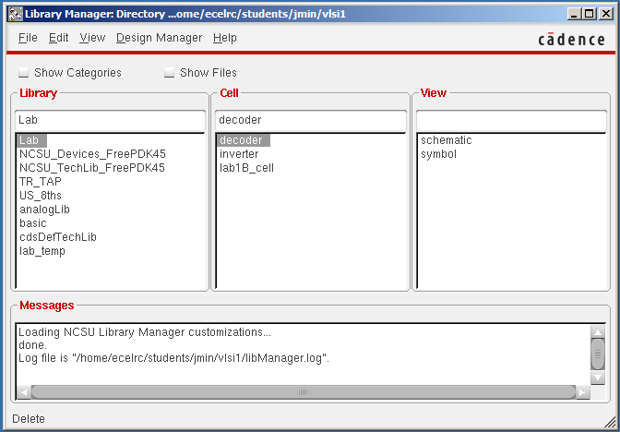
Schematic
Library Manager

Slide 7
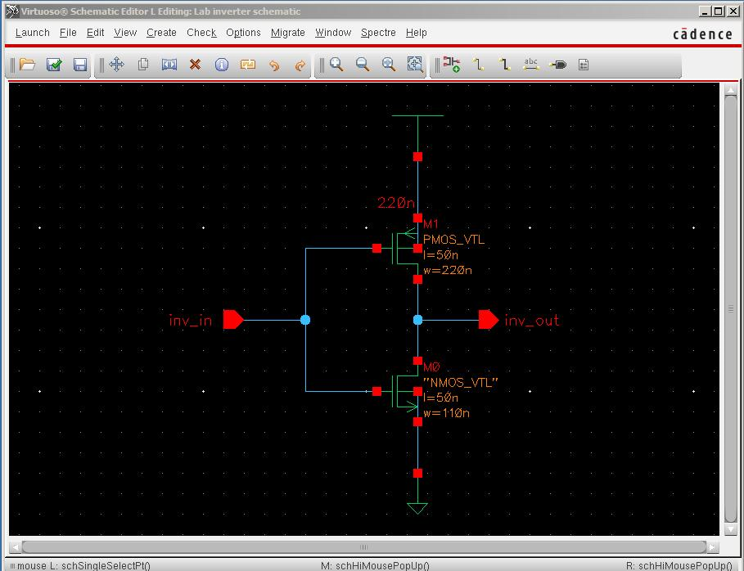
Schematic
Example: Inverter

Slide 8
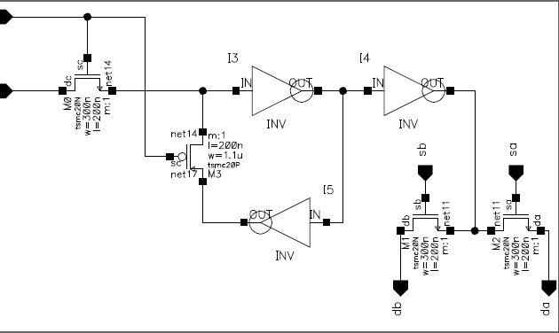
Symbol
It facilitates the hierarchical design
Top schematic can use the symbol for a sub-logic block

Slide 9
Functional Simulation
Functional simulation with Verilog-XL
No parasitic information
No delay information
It is for verifying the functionality of your design.
Verilog-XL uses a verilog testbench file as the stimulus input

Slide 10
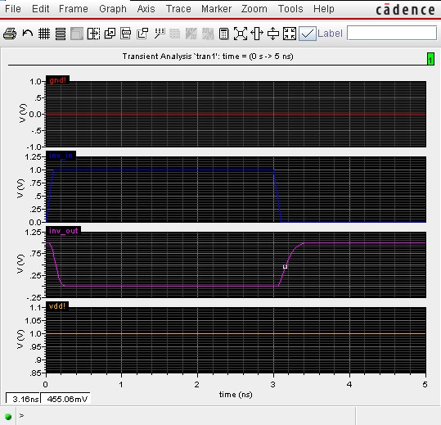
Pre-layout simulation
Pre-layout simulation with SPECTRE
  It includes the delay information.
Example

Slide 11
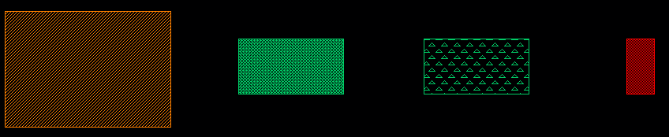
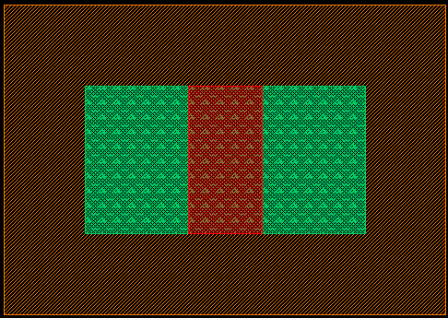
Layout
It represents planar geometric shape of IC
It consists of Poly, Active, N-well, and P-well
EXAMPLE
  NMOS
  P-Well + Active + Nimplant + Poly = NMOS

Slide 12
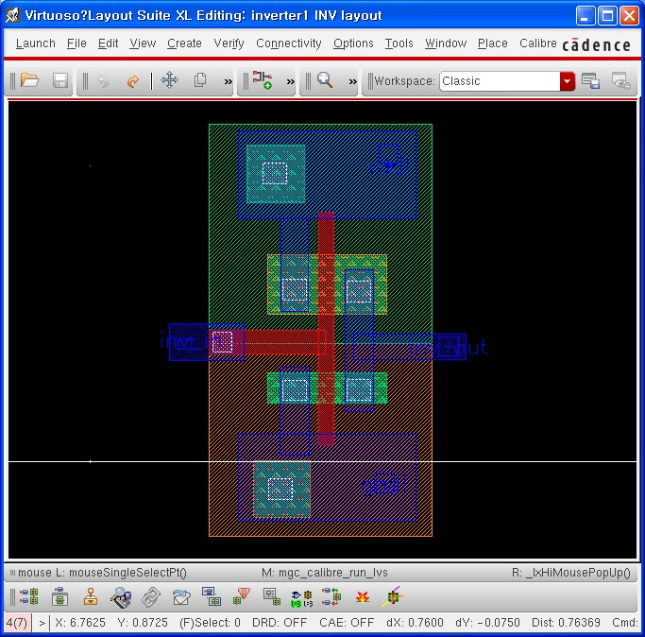
Layout

Slide 13
Layout
DRC (Design Rule Check)
  It is performed in Calibre using the DRC rule file.
  If you have errors in DRC, you should modify your layout design according to the error message.
  The error messages include information about the location and the source of the trouble.
  The ruler ( type k in the layout window) is very useful.

Slide 14
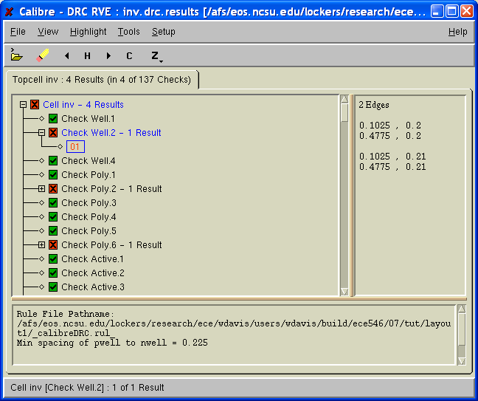
Layout
DRC example

Slide 15
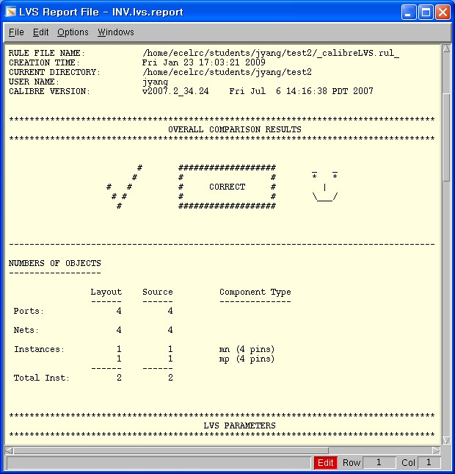
Layout
Layout Versus Schematic (LVS)
  Compares your schematic and your layout.
  Checks if both are identical in terms of connectivity
  It is performed in Calibre using the LVS rule file.

Slide 16
Extraction
Extracts the parasitic capacitance and resistance from the layout information.
It is executed in Calibre using the xRC rule file.
The file type of output files is HSPICE type.
  *.pex.netlist, *.pxi and *.pex

Slide 17
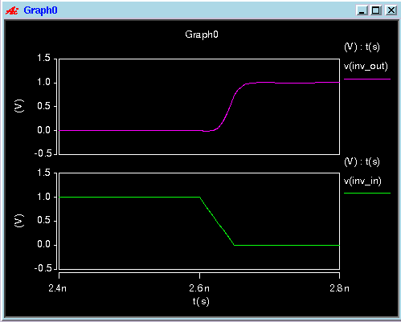
Extraction
Post layout simulation
  The three output files of the extraction are the inputs for HSPICE.
  After completing HSPICE, the output waveforms can be checked in CSCOPE.

Slide 18
Part A and B Overview
Lab1a (75%)
  Implement and optimize a 4-bit SRAM cell
    Full custom placement and routing
    Target is to minimize the cell area
    Schematic level and post layout level simulations
Lab1b (25%)
  1K memory array characterization
    Build your model for testing the worst case read delay
      Spectre simulator

Slide 19
Lab1a: Full Custom Design
Run through the flow with one inverter
  Follow the Cadence 2007 on-line tutorial step by step
Characterize the inverter (two control factors)
  Output load (100fF, 200fF, 500fF)
  Slew (input edge transition time, 10ps, 20ps, 50ps)
Implement and test the 1-bit memory cell
Implement, test and optimize the 4-bit memory cell
  Optimize for area
  Simulate for functionality

Slide 20
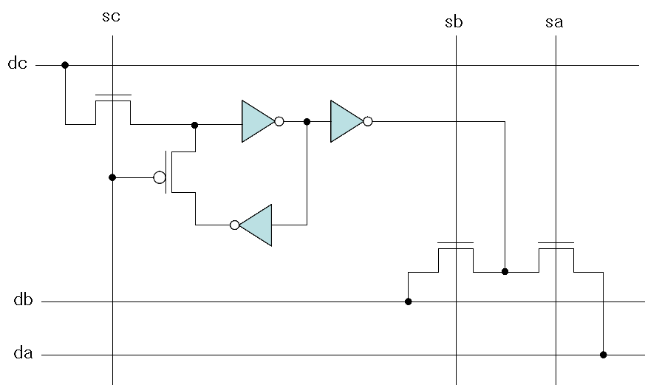
Lab1a: 1-bit SRAM Operation
3 data lines : data in (dc), data out (da, db)
3 control lines : write (sc), read (sa, sb)
sc = 1 : write (breaks the feedback loop)
sc = 0 : read

Slide 21
Lab1a: 4 – bit SRAM Cell
Within the design of the 1-bit SRAM cell
  Do not use metal 3
Within the design of the 4-bit SRAM cell
  May use metal 3
VDD rail on the right and GND rail on the left
VDD
GND
W
L

Slide 22
Lab1a: Grading Policy
Total score: 75% of Lab1
Inverter characterization: 15%
1-bit memory cell functionality: 30%
Area of 4-bit memory: 30%
  Smallest area == 30%
  Reduced scores as area increases from the minimum

Slide 23
Lab1b
Model the worst path of 1K memory array
  32 bit X 32 bit
  Schematic view only
  1-bit read only memory cell is provided
  NOR based 5-32 decoder is provided
Find out worst case “READ” time
  Construct high level critical path schematic
  Simulate output waveform with Spectre
  Read Vdd/2 delay time from the waveforms

Slide 24
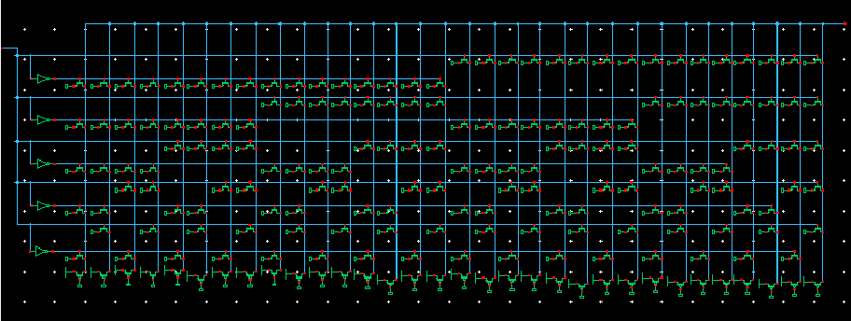
5-32 Decoder (provided)

Slide 25
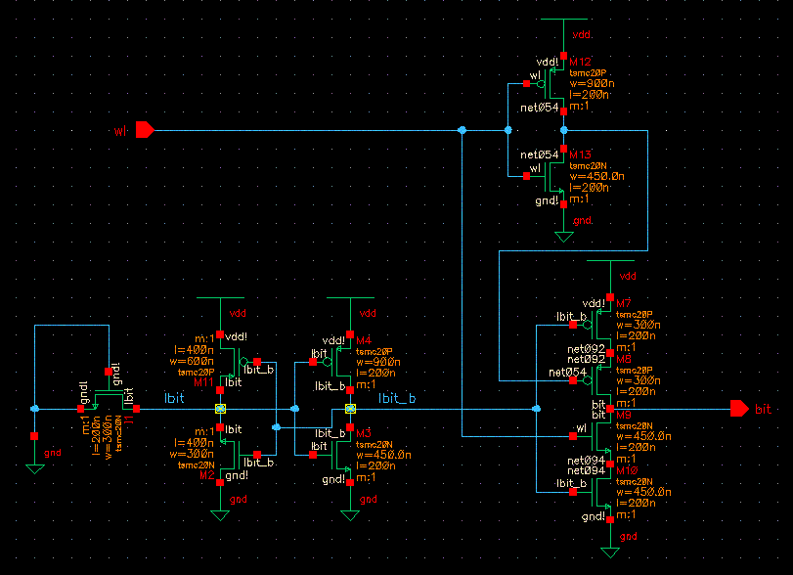
Read Only 1-bit Mcell (provided)

Slide 26
Memory Cell Access
Memory address
Memory Array
Word line
Decoder
(is given)
1-bit Memory Cell
(given, read only)
Bit line
Data coming out

Slide 27
Interconnect Delay Model FAQ
How to build model?
  Memory array access mechanism
  Interconnect RC (wire RC model)
  Only part of the memory array is required
How to setup the value in the memory cell?
What value should it be?
Which test pattern gives the longest delay?
How to use the Spectre simulator?
  Detailed tutorial provided in the lab web pages

Slide 28
Lab1b: Grading Policy
Total score: 25% of Lab1
Memory array delay model: 15%
  Schematic level
Simulation correctness: 10%
  Raw netlist modification
  Spectre simulation

Slide 29
Start Early, Submit Early!
Early submissions
  Submit 2 Days Ahead
    10% of your score added as a bonus
  Submit 1 Days Ahead
    5% of your score added as a bonus
Late penalties
  -5% per day late
  Maximum -25%
  Zero credit after the maximum penalty

Slide 30
Good Luck!

